Slide 1
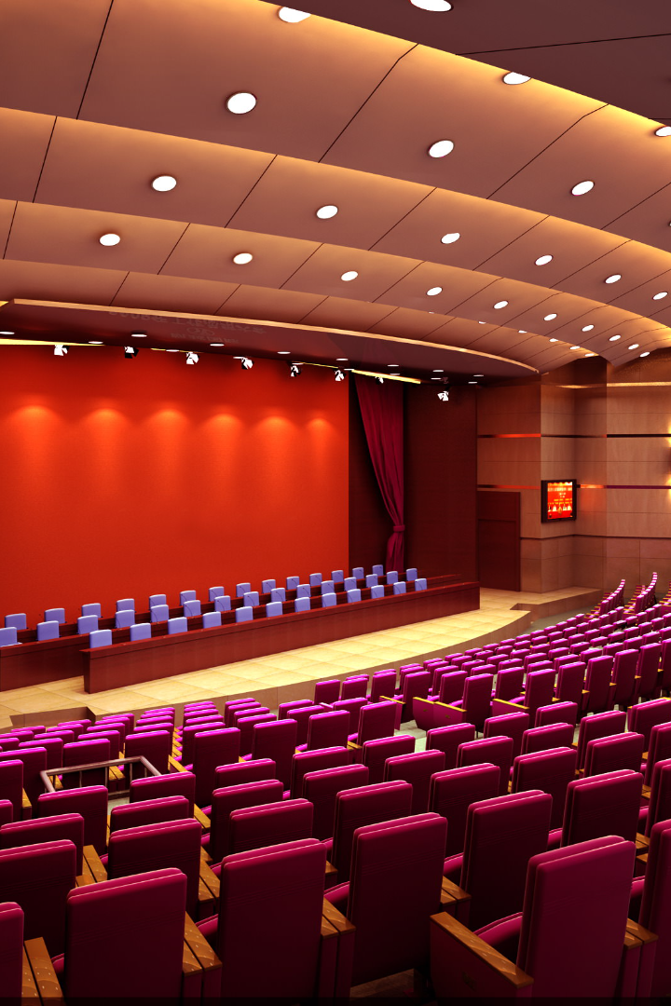

KCCEMSR Events
Welcome to the exciting world of KCCEMSR Events!
All-in-one solution for staying in the know about the vibrant campus activities.

Slide 2
Introduction
Created with the needs of college students in mind, this website serves as a central hub for discovering and engaging with various clubs and the exciting events they organise within our college. Our platform is designed to simplify the process of navigating the various clubs. Students can effortlessly explore various clubs, each catering to unique interests, hobbies, and causes. With comprehensive club profiles, and a full calendar of upcoming events, this events website makes it a lot easier for students to navigate and learn about various clubs and their events. The heart of KCCEMSR Events is its dynamic event calendar. This feature ensures you're always in the loop regarding upcoming events organised by these clubs. From social gatherings, festive events and athletic competitions, you can get notified about all the events that you want, ensuring you never miss out on exciting opportunities to engage with your club and the community. Moreover, KCCEMSR Events empowers club leaders with tools to effortlessly promote their events. With KCCEMSR Events, we've created a user-friendly, one-stop solution that brings the entire spectrum of college events to your fingertips.

Slide 3

Abstract
Key Features:
Easy exploration of various clubs catering to unique interests, hobbies, and causes.
Comprehensive club profiles and a full calendar of upcoming events for easy navigation and learning.
Dynamic event calendar to stay updated on all upcoming events organized by clubs, ensuring you never miss out on exciting opportunities to engage with your club and the community.

Slide 4
Code
Languages use in the website are HTML, Javascript, CSS.

Slide 5
Screenshots
Get a glimpse of the cutting-edge projects developed by our talented students. Witness their ingenuity and see how they transform ideas into reality.

Slide 6

Flow of Website
1
Homepage
As soon as you land on the homepage, you'll be greeted with a visually captivating interface that showcases the vibrant college community at KCCEMSR. The homepage acts as a gateway to explore various clubs, their profiles, and upcoming events.
2
Clubs
Once you click on the "Clubs" section, you'll be presented with a comprehensive list of clubs catering to unique interests, hobbies, and causes. Each club profile offers detailed information about the club's activities, and contact details. Clubs like Student Council, NSS, Rotract etc.
3
Events
The website also features a dynamic event calendar that keeps you updated on all the upcoming events organized by the different clubs. From workshops and seminars to social gatherings and competitions, this calendar ensures that you never miss out on any exciting opportunities to engage with your preferred club and the community. Stay connected, be informed, and seize every chance to be a part of the vibrant club culture at KCCEMSR.

Slide 7
Future Scope
Innovative Features
Expanded Network
Stay ahead of the curve with upcoming features that will revolutionize the digital landscape and elevate user experiences.
Connect with experts, industry leaders, and like-minded individuals, expanding your network of opportunities and collaborations.
Research Opportunities
Enhanced Learning
Discover avenues for research and experimentation in emerging fields, contributing to the progress and development of pioneering ideas.
Continue your educational journey with specialized courses, workshops, and resources tailored to the future needs of the ever-evolving professional landscape.

Slide 8


Conclusion and Call to Action
Join us as we foster a spirit of innovation and creativity. Together, let's shape the future. Register now for an unforgettable experience!

